Slide 1
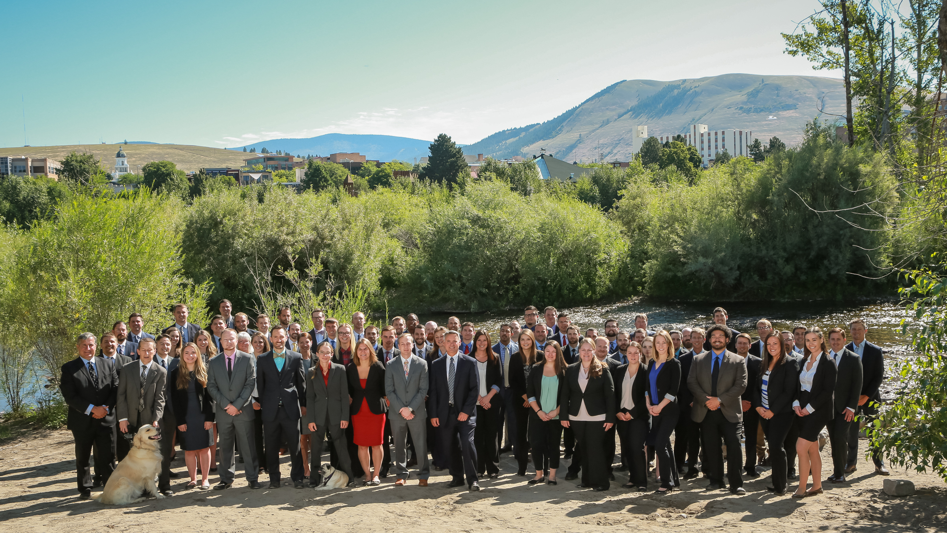
Public-Private Collaboration in Action

Slide 2
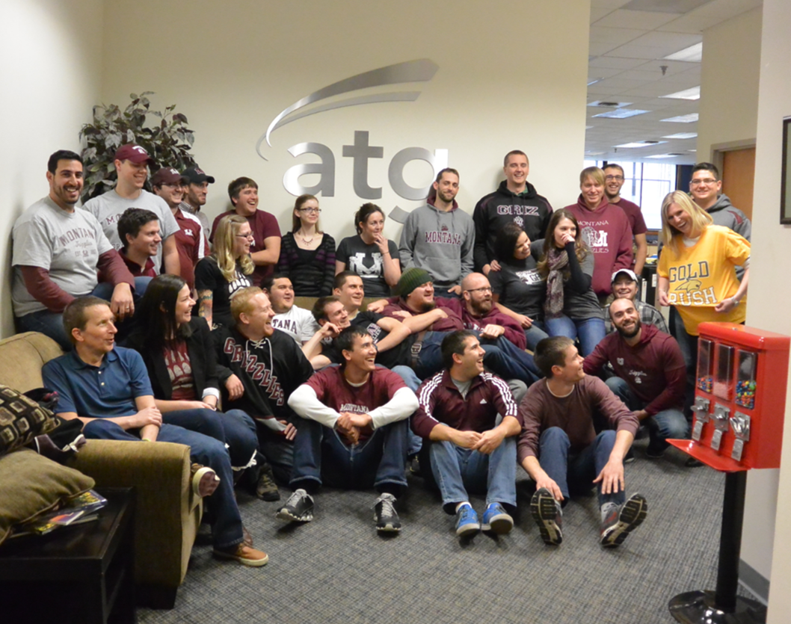
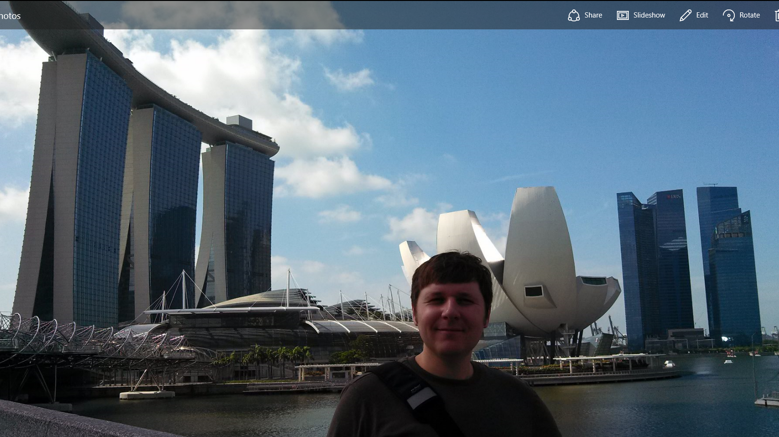
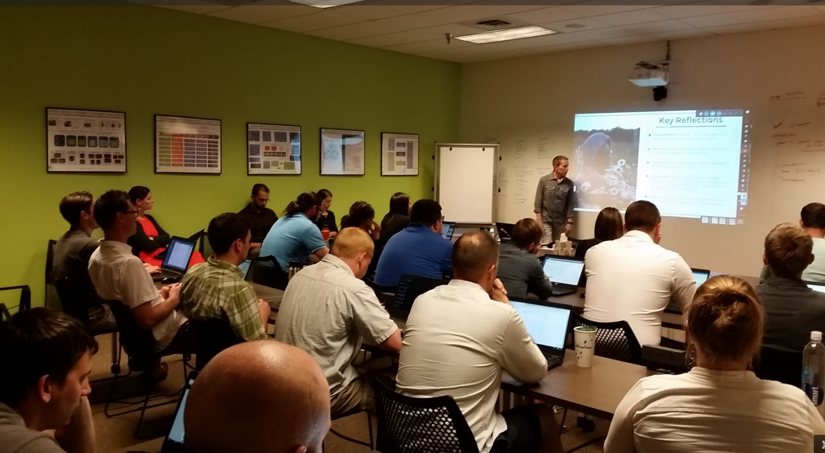
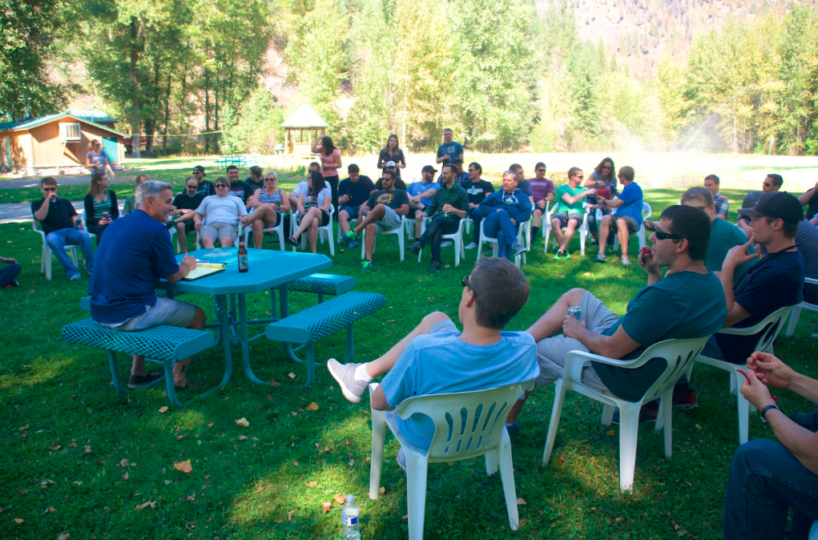
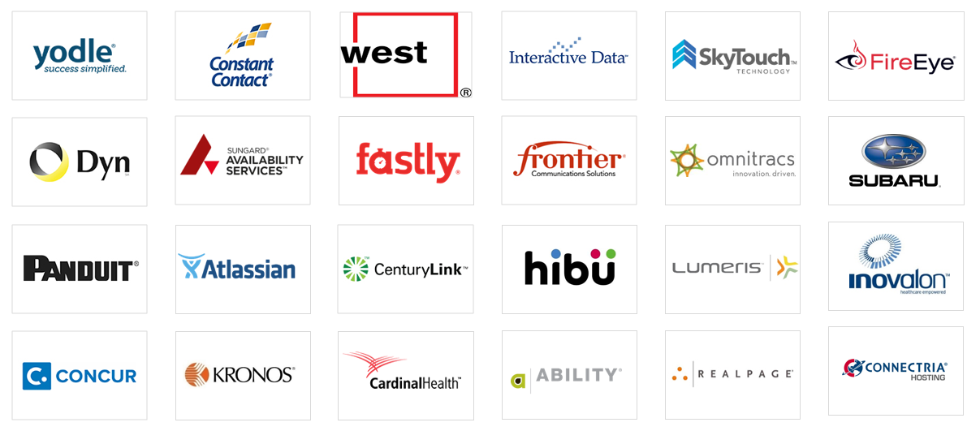
ATG Snapshot(s)
2
What:
Technology Consulting Company
Focus on Fortune 500 - Enterprise, Global, Cloud/SaaS Industry
Who:
90 People in Missoula Office
70+ from University of Montana
Added 28 Employees in 2016
Projecting 26 to 40 New in 2017
How:
Heavy Focus on Training, Mentoring, and Team Building
Highly Competitive Salaries
Mid 40k’s for Entry Level
Average in the Low 80k’s
Unique Office Culture, Strong Community Engagement
90 and Growing Fast…
Jay Allen Marketing Training
Cool Technology Clients
Grizzlies travel the globe…
Relaxed, Family Oriented Work Culture
Grizzlies on Display….with one Bobcat photobomb
CONFIDENTIAL | ATG Employees & Partners Only

Slide 3
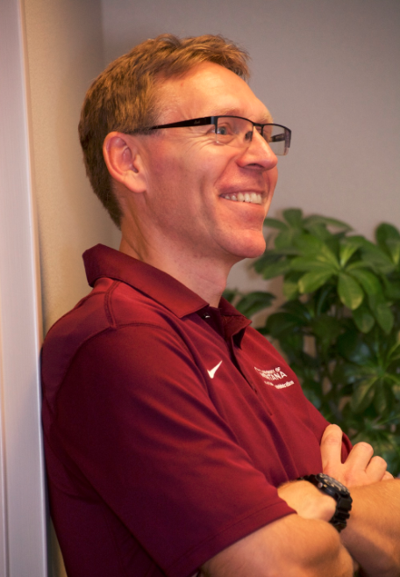
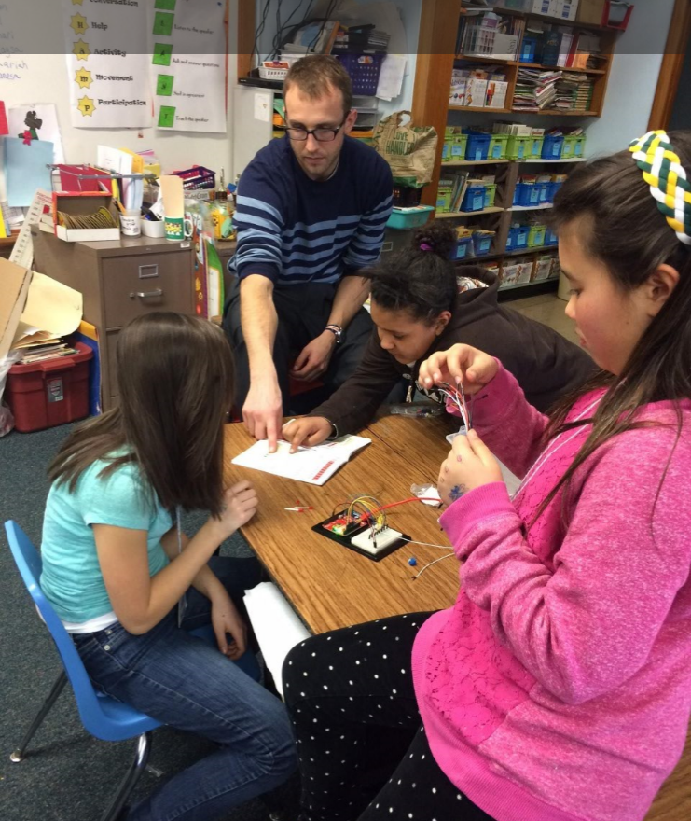
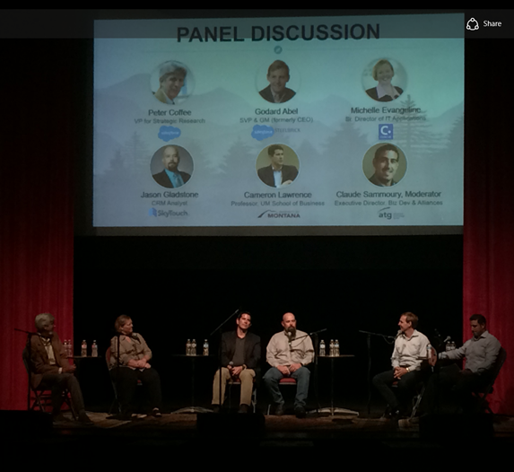
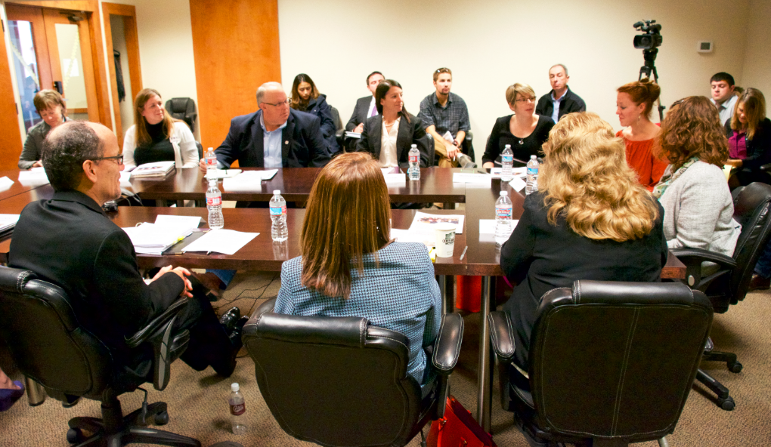
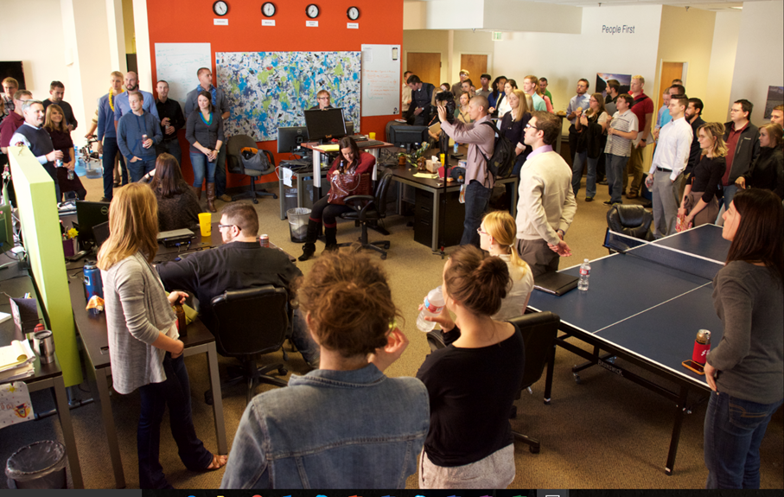
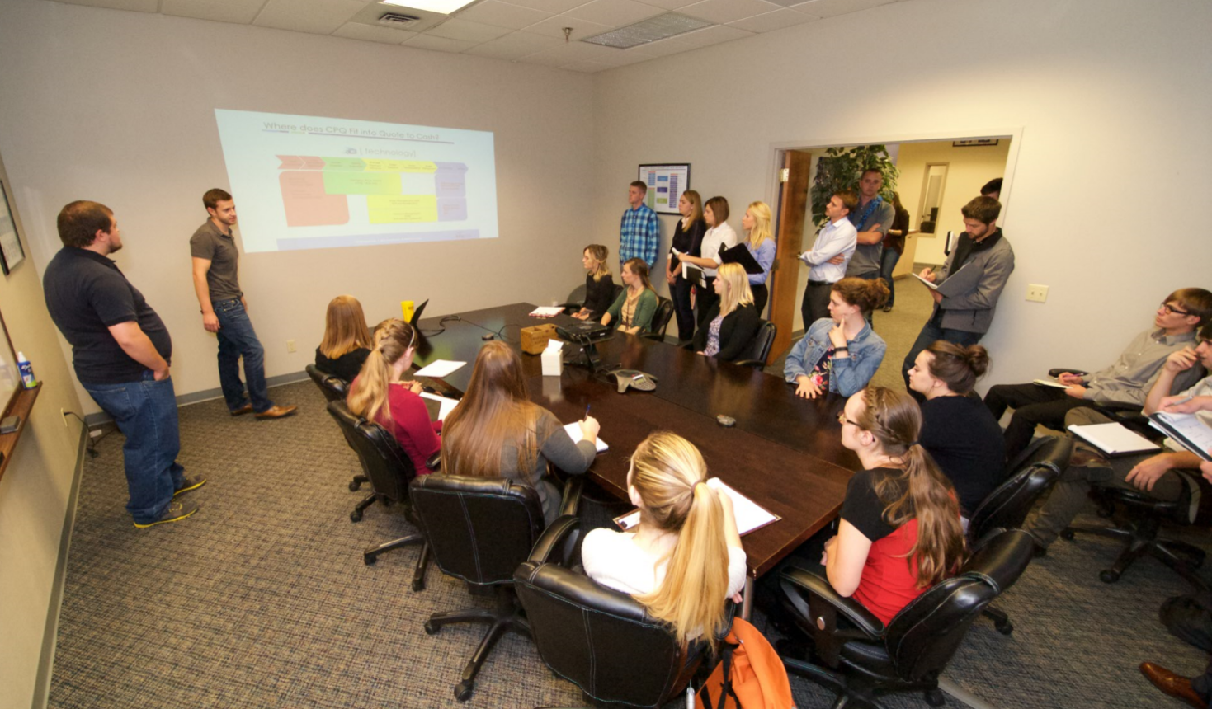
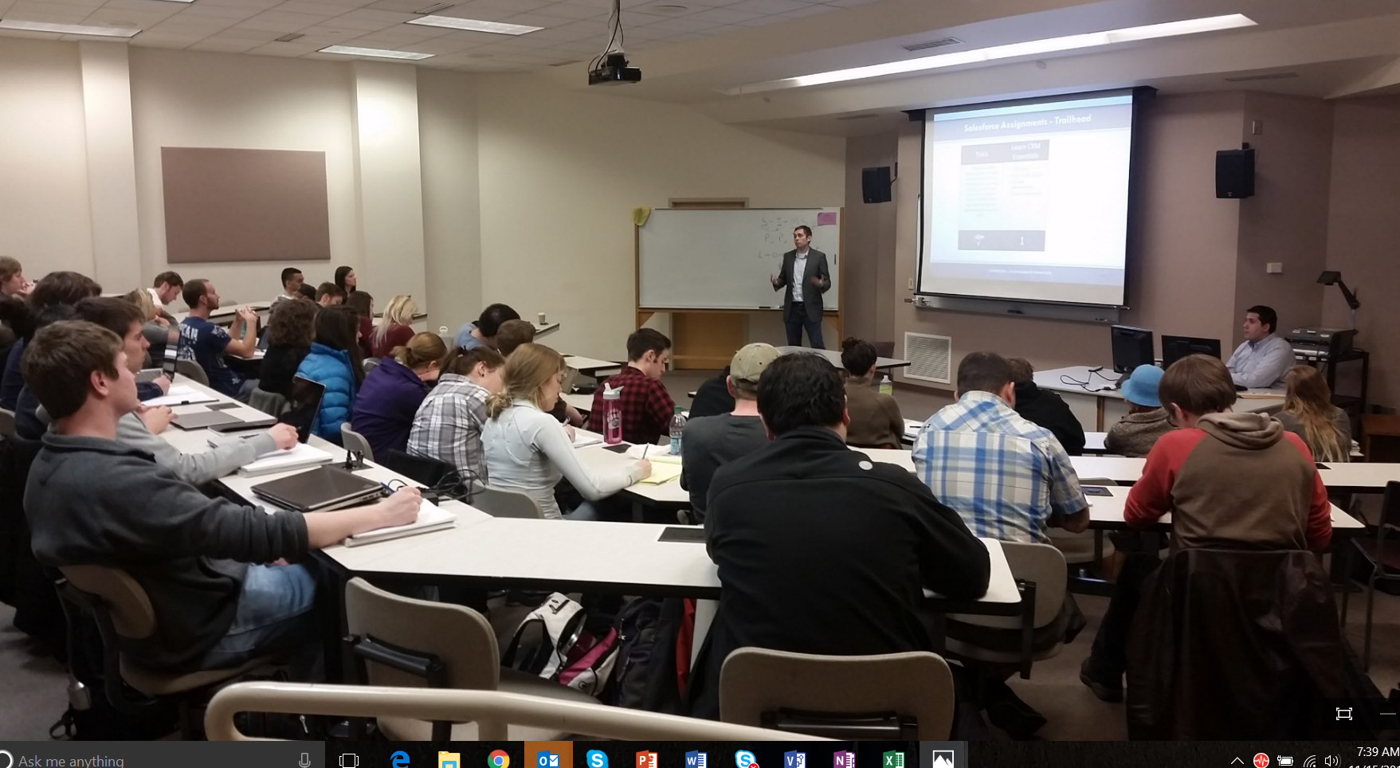
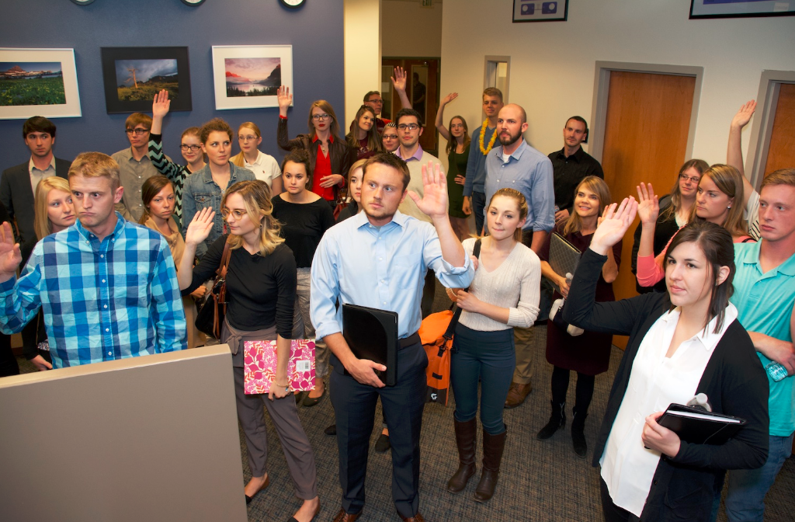
3
ATG and the University of Montana
Critical to starting ATG in 2010
David Firth and Cameron Lawrence – The ‘Godfathers of ATG’
The Classroom in ATG
“Systems Analysis and Design” in action
“Day in the life of a Consultant”
ATG in the Classroom
ATG guest lectures in MBA, MIS, Computer Science classes
BMIS 372 Collaboration – “Hands on SaaS, IaaS”
ATG and UM in the Community
SpectrUM SOKS Program Support
Joint Technology Events
Secretary of Labor Thomas Perez visit
Salesforce.com Peter Coffee and Godard Abel
ATG , U of M, and Secretary of Labor Thomas Perez
ATG and Dr. Firth’s System & Analysis Design
A Day in the Life of a Consultant…
Alums William Devich and Zeke Baied in BMIS 372
Dr. Cameron Lawrence with Industry Big Wigs
U of M MISA in ATG Office
Dr. David Firth – “Godfather of ATG”
Mike Newman and Franklin School 4th Graders
CONFIDENTIAL | ATG Employees & Partners Only

Slide 4
Thank you!
Advanced Technology Group
St. Louis
Kansas City
Missoula
Cincinnati
Denver
Dallas
Atlanta

